Slide 1
Wireless for the Internet of Things Introduction to Networking
CS/ECE 4501
Spring 2023
UVA
[Pannuto, Ghena, Campbell]

Slide 2
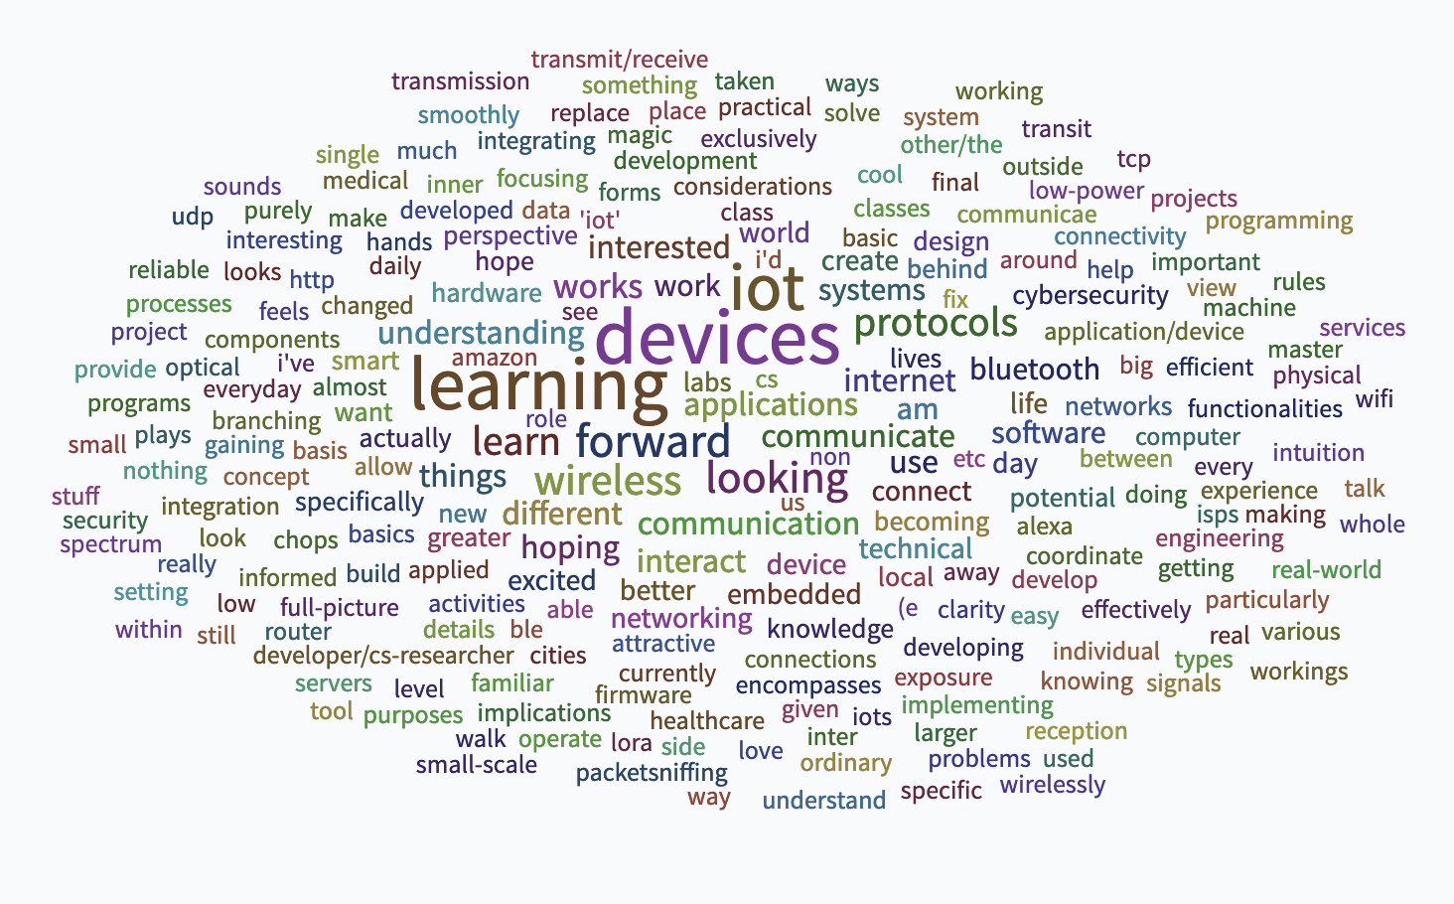

Slide 3
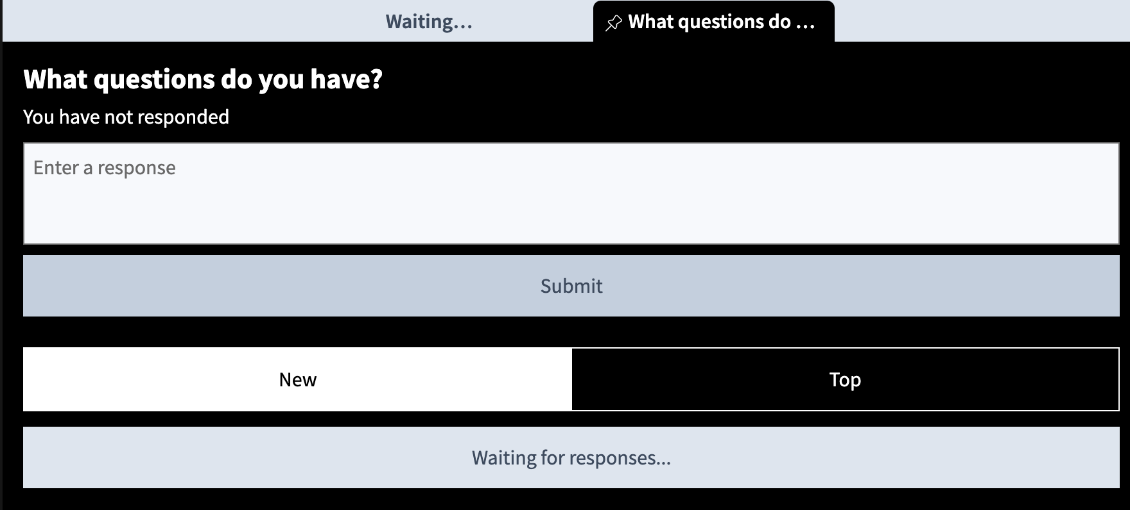
pollev.com/wiotbc

Slide 4
Today’s Goals
Introduce layered network architecture
Introduce internet structure and services
Provide enough general networking context for this class

Slide 5
Communication layers
Application
Transport
Network
Data Link
Physical
What goes on at each of these?

Slide 6
Internet protocol stack
application: supporting network applications
IMAP, SMTP, HTTP
transport: process-process data transfer
TCP, UDP
network: routing of datagrams from source to destination
IP, routing protocols
link: data transfer between neighboring network elements
Ethernet, 802.11 (WiFi), PPP
physical: bits “on the wire”
application
transport
network
link
physical

Slide 7
OSI model of communication layers
Application
Transport
How to form connections between computers
TCP and UDP
Network
How to send packets between networks
IP
Data Link
How to send frames of data
Ethernet, WiFi
Physical
How to send individual bits
Ethernet, WiFi
CS/ECE 4457
WIoT
ECE courses

Slide 8
Protocols are “layered”
Headers for each layer of communication wrap data
Data is wrapped with header for the network to make a packet
Packet is wrapped with header for the link to make a frame
Encapsulation is a key concept
Internet Packet
Data
Packet Header
Frame Header
Ethernet Frame

Slide 9


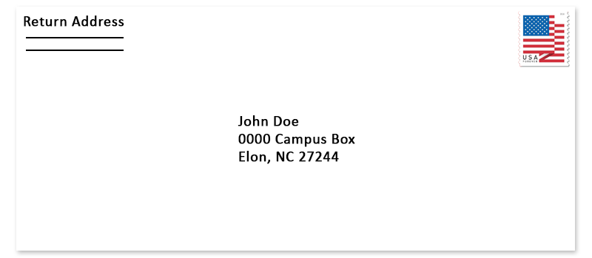

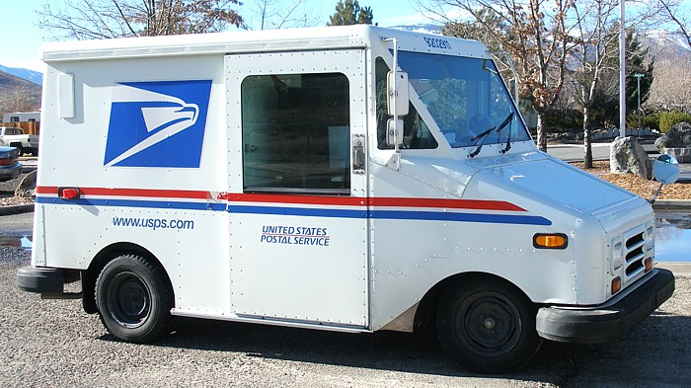


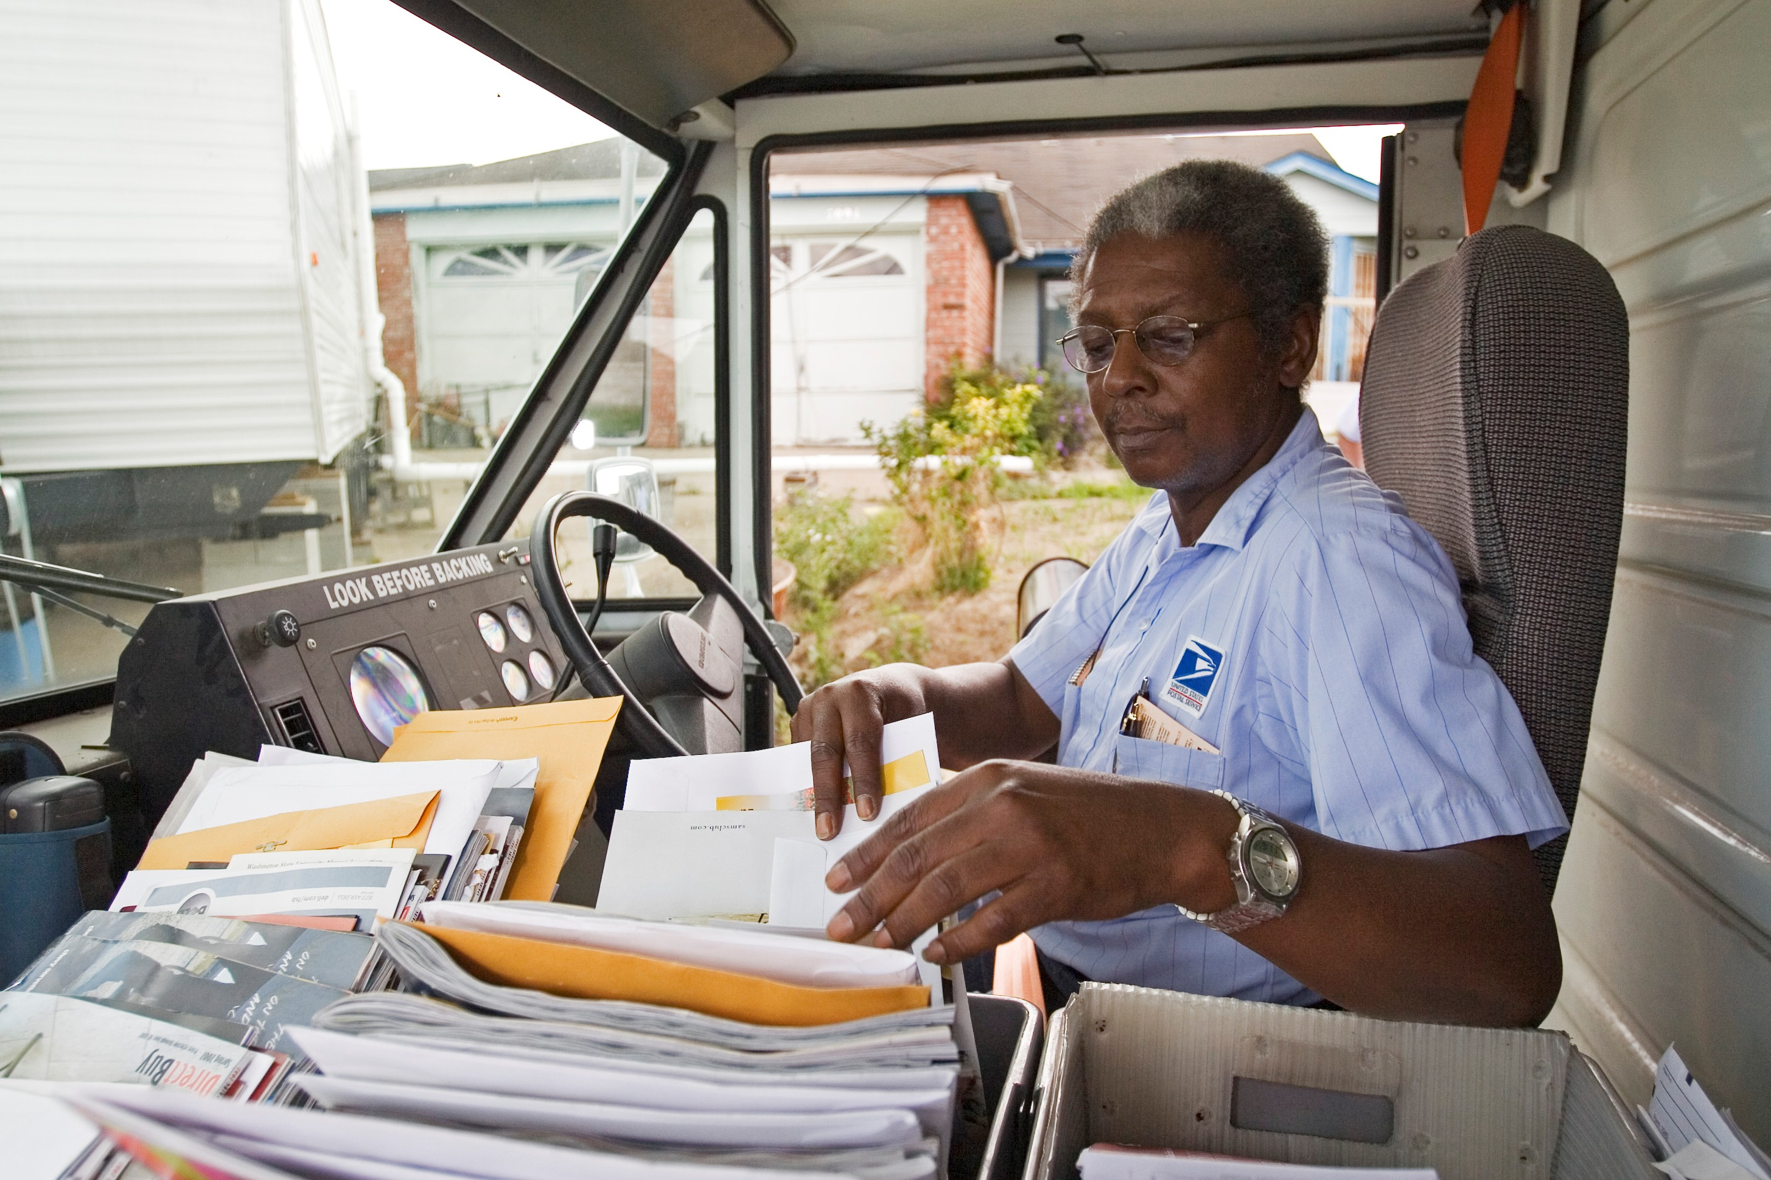
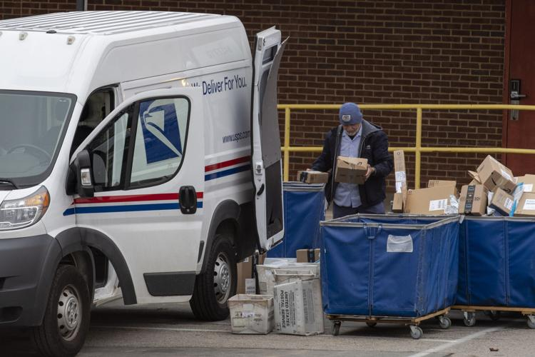
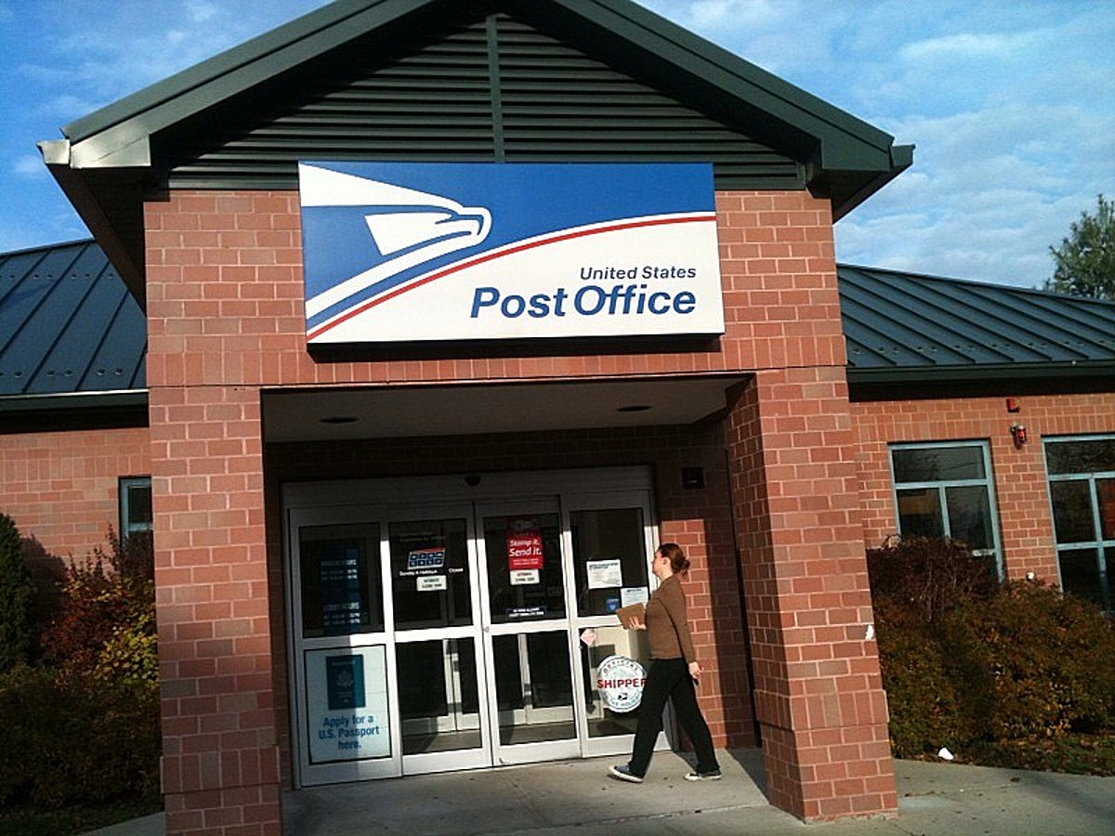
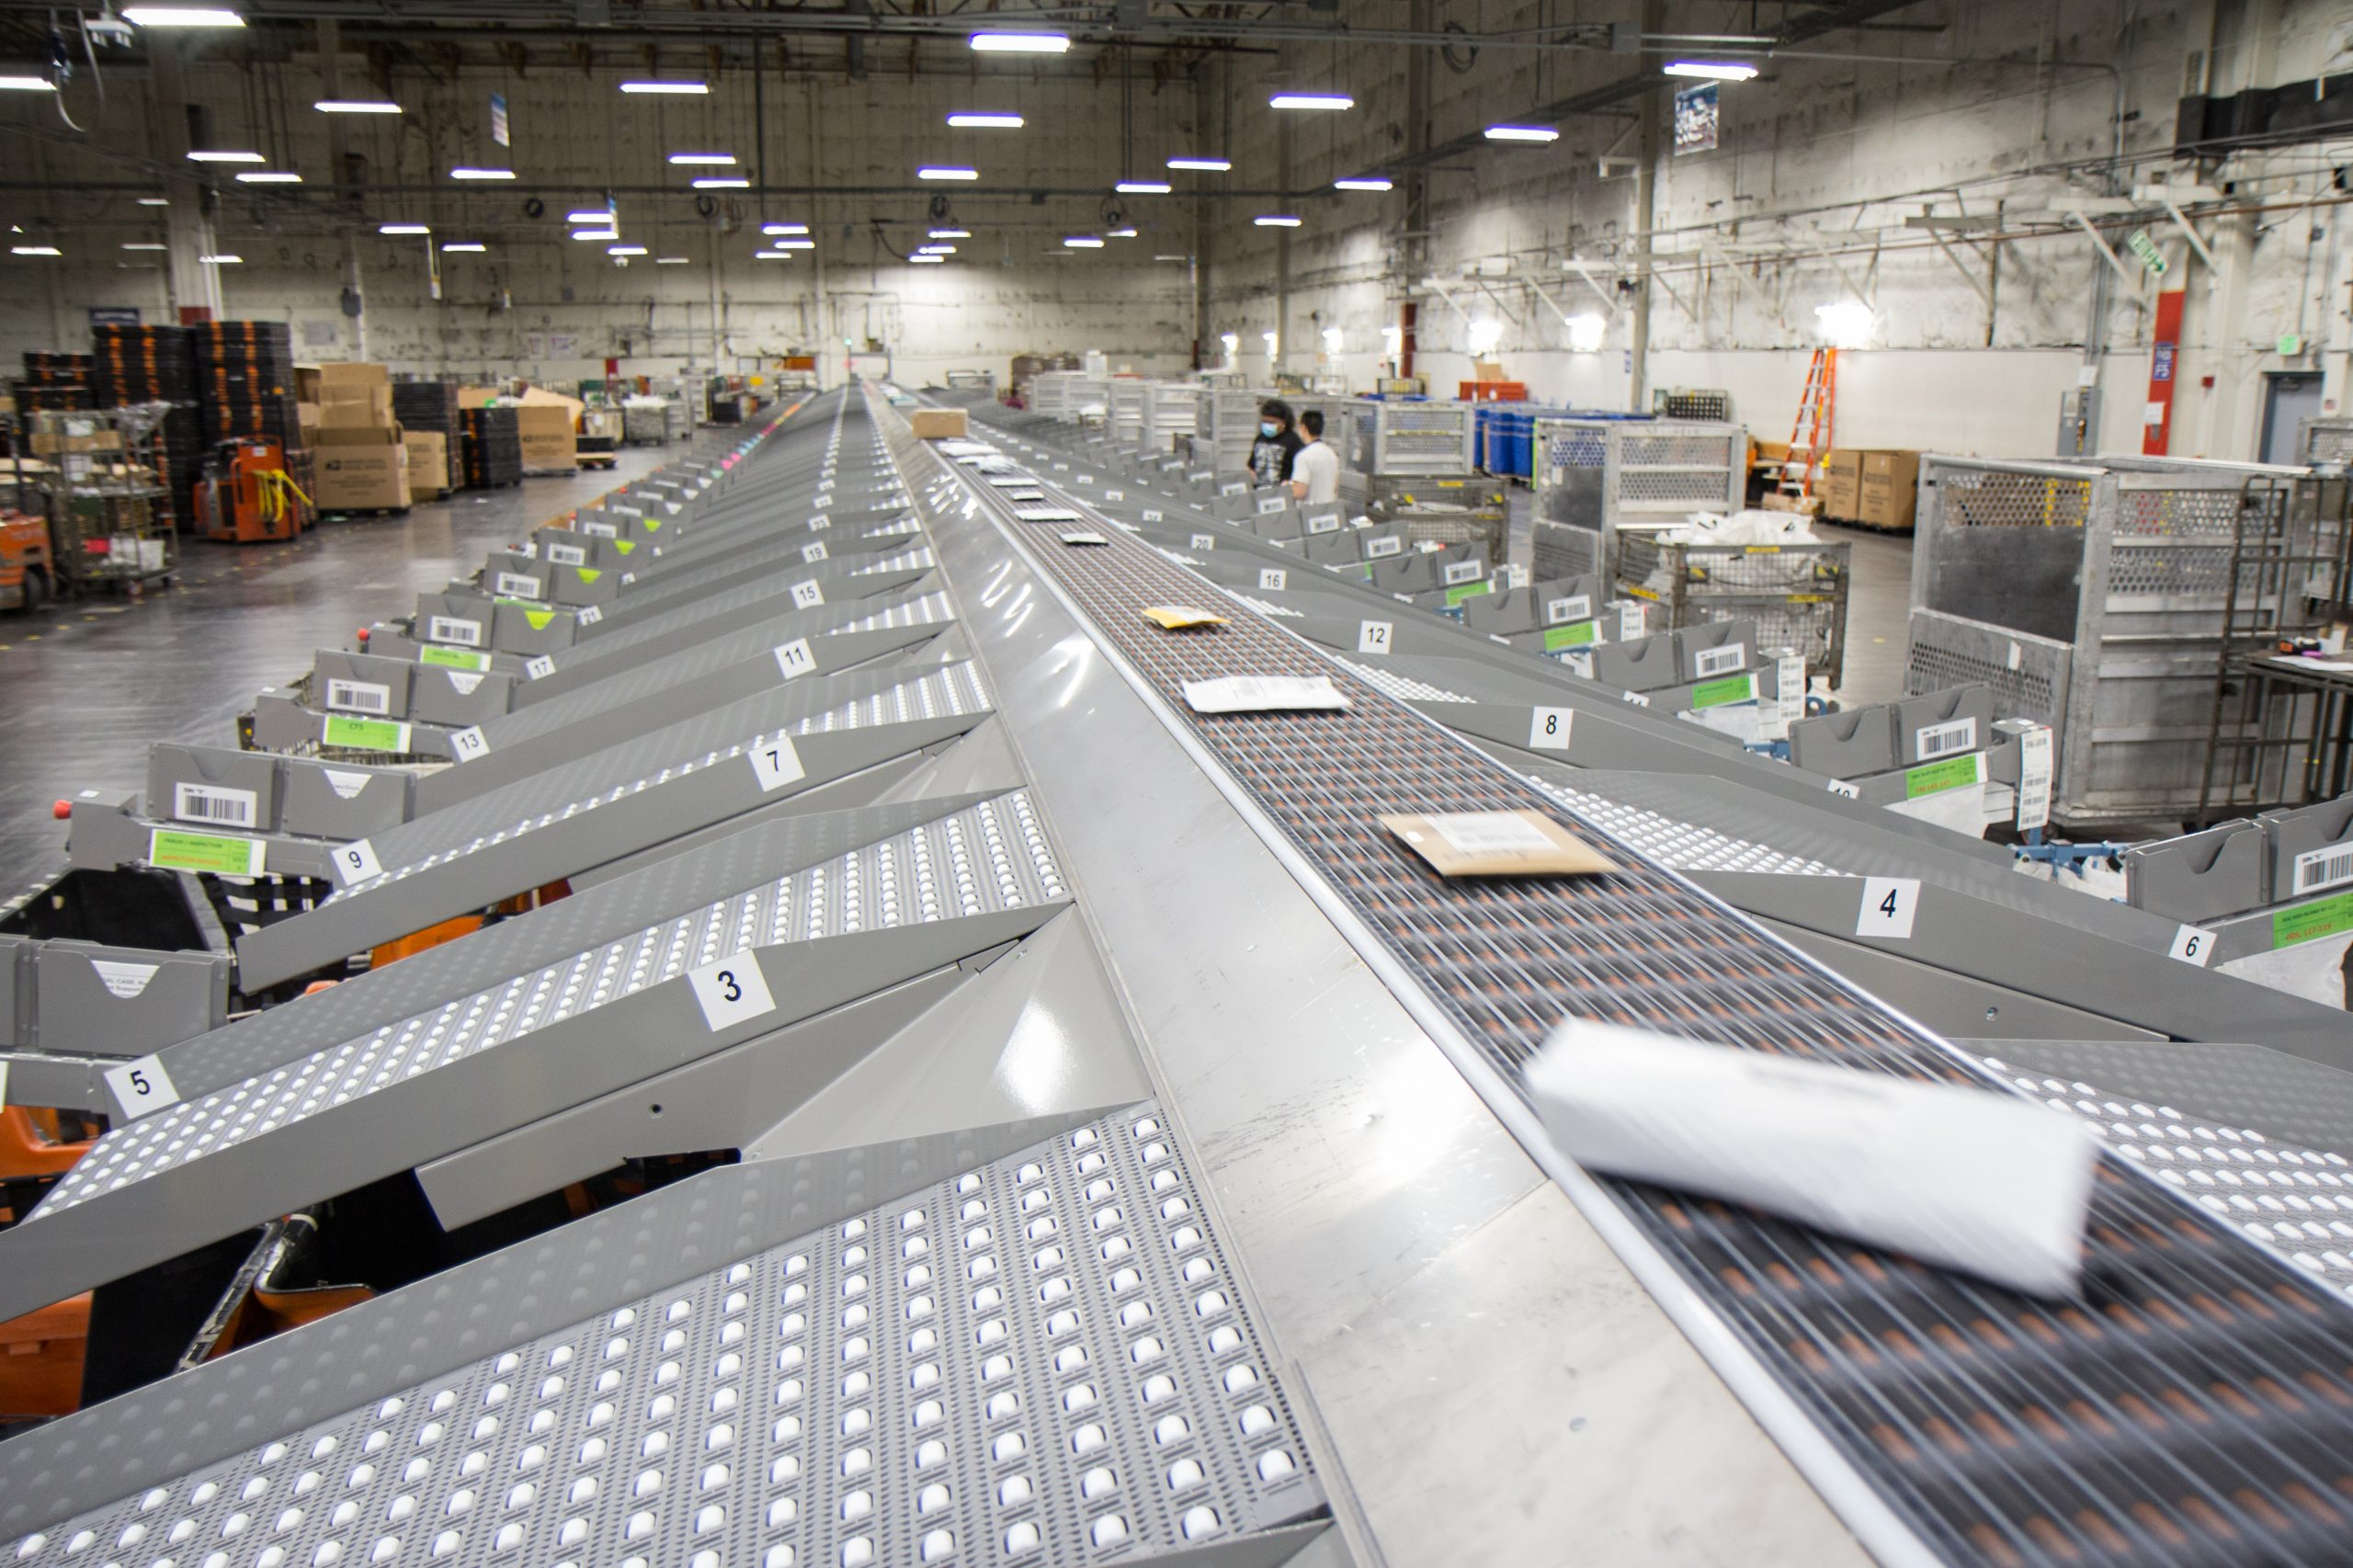
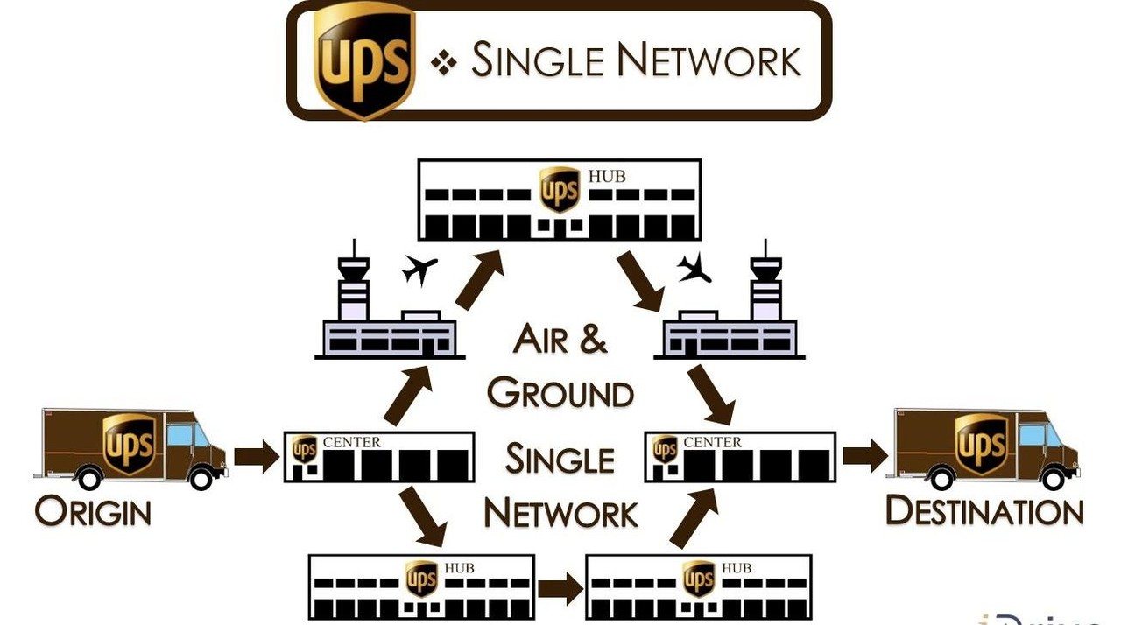
Analogy: Sending a letter
Application: Purpose/type of letter
Transport: Carrier service
Network: Street Address
Link: Transfer to post office
Physical: Moving tangible object
Courier
Named recipient
Mailing/shipping infrastructure

Slide 10
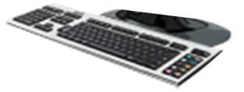
Host: sends packets of data
host sending function:
takes application message (string of bits, really)
breaks into smaller chunks, known as packets, of length L bits
transmits packet into access network at transmission rate R
link transmission rate, aka link capacity, aka link bandwidth
two packets,
L bits each
2
1
host
R: link transmission rate
packet
transmission
delay
time needed to
transmit L-bit
packet into link
L (bits)
R (bits/sec)
=
=

Slide 11
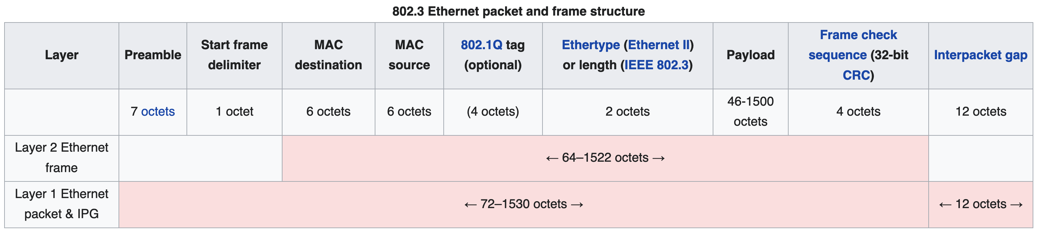
Protocols are “layered”
Headers for each layer of communication wrap data
Data is wrapped with header for the network to make a packet
Packet is wrapped with header for the link to make a frame
Internet Packet
Ethernet Frame

Slide 12

Encapsulation
source
message
M
application
transport
network
link
physical
segment
H_{t}
M
H_{t}
datagram
H_{n}
H_{n}
H_{t}
M
frame
H_{l}
H_{n}
H_{t}
M
link
physical
switch
destination
H_{n}
H_{t}
M
network
link
physical
M
application
transport
network
link
physical
H_{l}
H_{n}
H_{t}
M
H_{n}
H_{t}
M
H_{t}
M
H_{n}
H_{t}
M
H_{l}
H_{n}
H_{t}
M
router

Slide 13
Transmitting data between networks
LAN1
Host A
Host B
LAN2
client
server
(1)
data
(8)
data
protocol
software
protocol
software
internet packet
(2)
data
PH
(7)
data
PH
LAN1
adapter
LAN2
adapter
LAN1 frame
Router
(3)
data
PH
FH1
(6)
data
PH
FH2
LAN1
adapter
LAN2
adapter
PH: Internet packet header
FH: LAN frame header
LAN2 frame
(4)
data
PH
FH1
data
PH
FH2
(5)
protocol
software

Slide 14
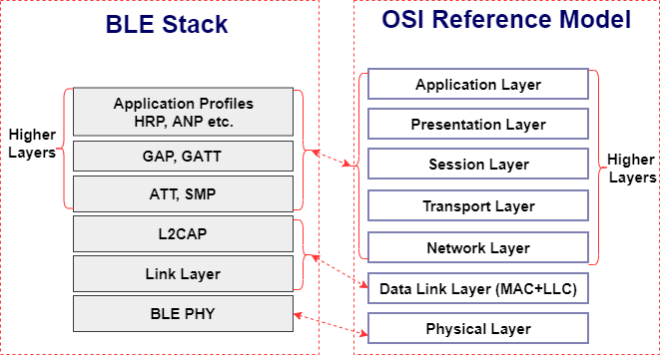
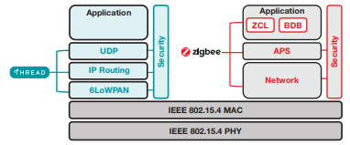
Model is not always reality
Wireless protocols don’t always split between layers cleanly
Usually explain parts of physical, data link, and possibly upper layers
Model still helps conceptualize stack-up though
Layering of some type still occurs

Slide 15
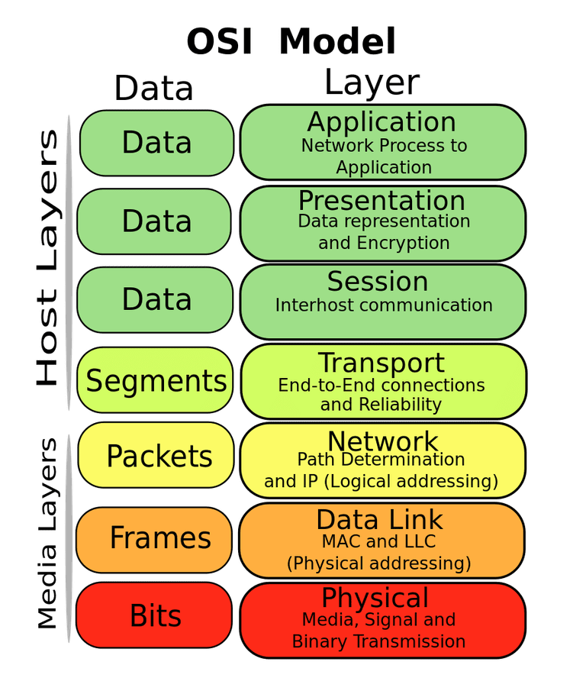
Layering for IoT (joke) (kind of)
MQTT
MQTT is a publish/subscribe message broker

Slide 16
Outline
OSI Layers
Internet Architecture (“The Upper Layers”)

Slide 17
Order the network layers
Pollev.com/wiotbc
application, link, network, physical, transport

Slide 18
















The Internet: a “nuts and bolts” view
Internet: “network of networks”
Interconnected ISPs
mobile network
4G
national or global ISP
protocols are everywhere
control sending, receiving of messages
e.g., HTTP (Web), streaming video, Skype, TCP, IP, WiFi, 4G, Ethernet
IP
Streaming
video
Skype
local or regional ISP
home network
content
provider
network
Internet standards
RFC: Request for Comments
IETF: Internet Engineering Task Force
HTTP
datacenter
network
Ethernet
TCP
enterprise
network
WiFi

Slide 19
The global Internet
Most famous example of a network
Based on the TCP/IP protocol family
Network Layer
IP (Internet Protocol)
Provides a naming scheme and unreliable delivery of packets from host-to-host
Transport Layer
UDP (Unreliable Datagram Protocol)
Uses IP to provide unreliable data delivery from process-to-process
TCP (Transmission Control Protocol)
Uses IP to provide reliable data delivery from process-to-process
Accessed via a mix of Unix file I/O and the sockets interface

Slide 20
What’s a protocol?
Human protocols:
“what’s the time?”
“I have a question”
introductions
… specific messages sent
… specific actions taken when message received, or other events
Network protocols:
computers (devices) rather than humans
all communication activity in Internet governed by protocols
Protocols define the format, order of messages sent and received among network entities, and actions taken on msg transmission, receipt

Slide 21
Hardware and software organization of an Internet application
Internet client host
Internet server host
Client
User code
Server
Sockets interface
(system calls)
TCP/IP
Kernel code
TCP/IP
Hardware interface
(interrupts)
Network
adapter
Hardware
and firmware
Network
adapter
Global IP Internet

Slide 22
A programmer’s view of the internet
Hosts are mapped to a set of 32-bit IPv4 addresses
52.87.65.167
The set of IP addresses is mapped to a set of identifiers called Internet domain names
52.87.65.167 is mapped to linklab.virginia.edu
A process on one Internet host can communicate with a process on another Internet host over a connection

Slide 23
IP addresses
32-bit IP addresses are stored in an IP address struct
IP addresses are always stored in memory in network byte order (big-endian)
Remember: most computers use little-endian 😭
True in general for any integer transferred in a packet header from one machine to another
E.g., the port number used to identify an Internet connection
By convention, each byte in a 32-bit IP address is represented by its decimal value and separated by a period
IP address: 0x8169071E = 129.105.7.30
/* Internet address structure */
struct in_addr {
uint32_t s_addr; /* network byte order (big-endian) */
};

Slide 24
Domain Naming System (DNS)
The Internet maintains a mapping between IP addresses and domain names in a huge worldwide distributed database called DNS
Conceptually, programmers can view the DNS database as a collection of millions of host entries
Each host entry defines the mapping between a set of domain names and IP addresses
A special name: localhost
Refers back to the computer being used (IP address 127.0.0.1)

Slide 25
Internet connections
A socket is an endpoint of a connection
Socket address is an IPaddress:port pair
IP address identifies the computer
Port identifies the process on the computer
Clients and servers communicate by sending streams of bytes over connections. Most connections are:
Point-to-point: connects a pair of processes.
Full-duplex: data can flow in both directions at the same time,
[TCP adds] Reliable: stream of bytes sent by the source is eventually received by the destination in the same order it was sent.

Slide 26
Connection performance
Assume the maximum packet size is 128 bytes. You need to send 1 KB (1024 bytes). How long will this take on a 256 kbps link (ignoring other potential delays)?
10 milliseconds
32 milliseconds
4 seconds
32 seconds

Slide 27
Ports are used to identify services to the kernel
Server host 128.2.194.242
Client host
Service request for
128.2.194.242:80
(i.e., the Web server)
Web server
(port 80)
Client
Kernel
Echo server
(port 7)
Service request for
128.2.194.242:7
(i.e., the echo server)
Web server
(port 80)
Client
Kernel
Echo server
(port 7)

Slide 28
How does the Internet route packets? (simplified…)
IP layer
Describes the overall goal
Packets from my computer <---> Google
Link layer (Ethernet)
Describes individual links
Packets from my computer <---> McCormick Router
Routing
Get packets from one host to another

Slide 29
Addressing
How to solve the routing problem?
I need to know how to get data from me to you
How does the post office work?
I know where you live (your address)
Zip Code
City
Street
House Number
Name

Slide 30
Addressing
Your computer moves all the time
Home, school, Starbucks...

Slide 31
Addressing - Intranet and Internet
In general, network operators don’t change that often
Solution:
Tie IP addresses to network operators
Assign computers IPs as they join networks
Ex: When you move apartments, you get a new address
Key Point:
Networks “own” a block of IP address space
“The Internet” is a network of networks

Slide 32
Getting an IP from your building’s network\
Rice hall router “owns” 128.143.67.0-255
This is notated as 128.143.67.0/24
The first 24 bits are fixed, remaining 8 bits assigned to devices
cs.virginia.edu “owns” 128.143.67.11
128.143.67.11/32, usually omit the /32

Slide 33
Identifying your computer?
Every network card has its own MAC address
IPs are (somewhat) dynamic, “owned” by local networks
MACs are hardware and static, “owned” by specific computers
Manufacturers own blocks of MACs, use them each time they make a device
Connecting to a network
Your computer leases an IP from the local network
Only the local router knows your MAC, everyone else sees your IP
[n.b. this overview ignores NATs, which are commonplace today]

Slide 34

Routing
2.0.0.0/8
1.0.0.0/8
10.0.0.0/8
5.0.0.0/8
4.0.0.0/8

Slide 35
Routing
2.0.0.0/8
→10.0.0.0/8
1.0.0.0/8
→2.0.0.0/8
→10.0.0.0/8
10.0.0.0/8
5.0.0.0/8
→10.0.0.0/8
4.0.0.0/8
→5.0.0.0/8
→10.0.0.0/8

Slide 36
Routing - Adaptive
2.0.0.0/8
→10.0.0.0/8
1.0.0.0/8
→2.0.0.0/8
→10.0.0.0/8
10.0.0.0/8
5.0.0.0/8
→10.0.0.0/8
4.0.0.0/8
→5.0.0.0/8
→10.0.0.0/8

Slide 37
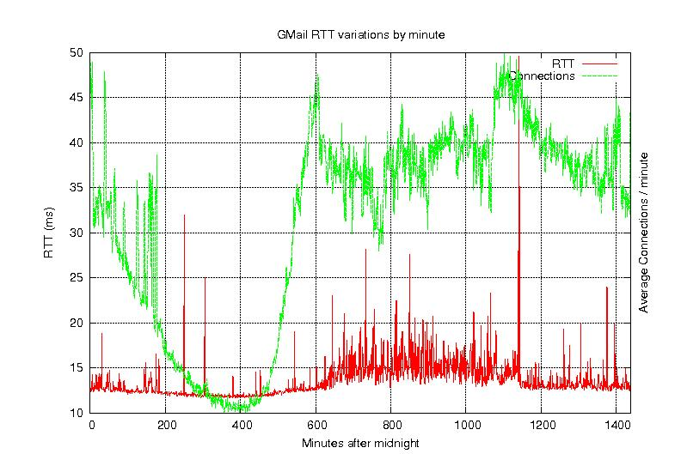
Routing – Congestion + Time

Slide 38
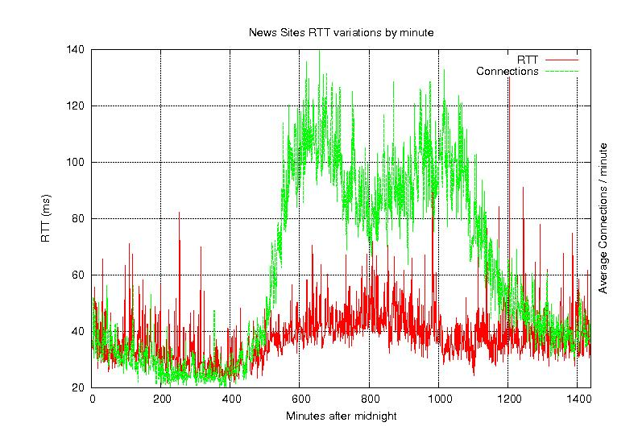
Routing – Congestion + Time

Slide 39
Routing – Other considerations [pre-2010, hah!]
Most ethernet packets have a Maximum Transmission Unit (MTU) of 1500 bytes
The fastest routers run at 10 GB/s
A 1 GHz processor can only do ~1000 instructions / packet
Tables must fit in cache
Memory accesses would cost ~100 instructions each
$$\frac{1500{bytes}/{packet}}{1073741824{bytes}/{second}}≈{1.4x10}^{−6}{seconds}/{packet}$$

Slide 40
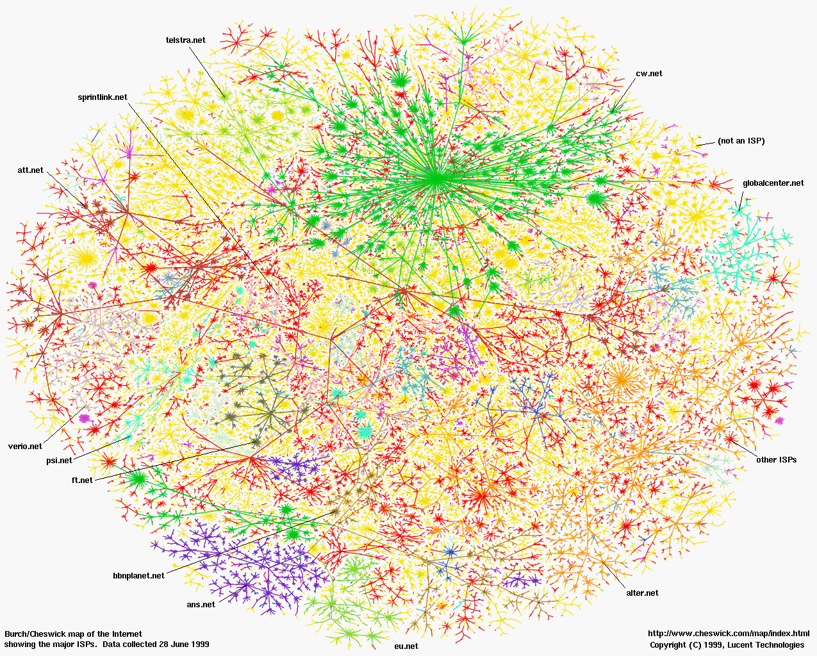
Some Perspective: North America (in June, 1999)

Slide 41
Internet structure: a “network of networks”
Networks of ISPs connect to provide global connectivity
…
…
access
net
access
net
access
net
access
net
access
net
IXP
access
net
access
net
ISP A
…
…
access
net
IXP
ISP B
access
net
ISP C
access
net
access
net
access
net
regional ISP
…
access
net
access
net
access
net
access
net
…

Slide 42

Some Perspective: The Internet

Slide 43
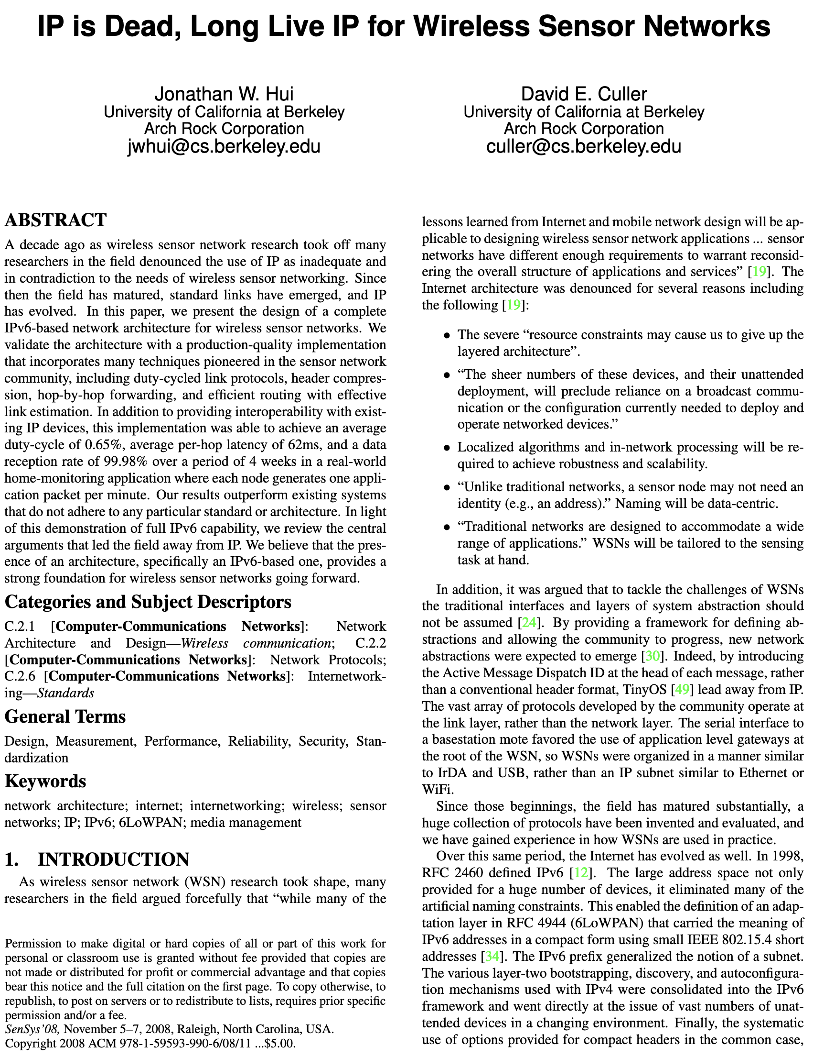
So how does the Internet of Things fit into the Internet?
“IP is the Narrow Waist of the Internet”
IP is Dead, Long Live IP for Wireless Sensor Networks
A recurring theme in this class:
How does this actually attach to the Internet
Physically [hello Hue Hub, Wyze Hub, August Hub, …]
Logically [are BLE devices really part of the internet?]

Slide 44
In which layer is…
Reliable transfer, ensuring packets successfully get from host to host?
DNS (Domain Name System), the database of mappings from domains to IP addresses.
Scheduling when a wireless device is allowed to "talk" (i.e. transmit packets).
The decision to route using Router A rather than Router B when forwarding packets.

Slide 45
What are the steps for viewing a website?
You enter a domain name for the website
Computer looks up domain name to get IP Address
Computer sends request to IP_address:80
Computer gets back data, which it renders into a website

Slide 46
ALL the layers
A “famous” interview question
“What happens when you type google.com into your browser’s address bar and press enter?”
https://github.com/alex/what-happens-when (11 pages!)
Keyboard events
Parsing URL
DNS lookup
Opening socket
HTTP protocol
HTML parsing
GPU rendering

Slide 47
Lab 1: How does your Internet work?
What can you learn about the network around you?
Play with Wireshark
Protocol analysis, introspection

